Slide 1

UNIT 1: Who am I?
The Browns

Slide 2
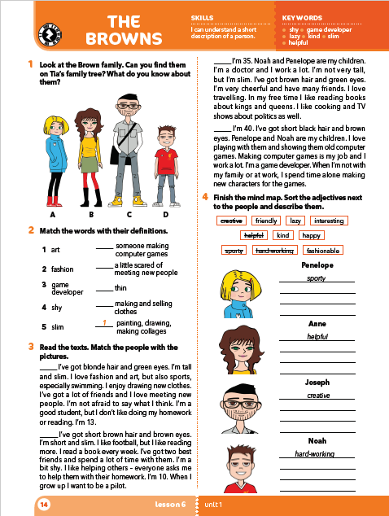
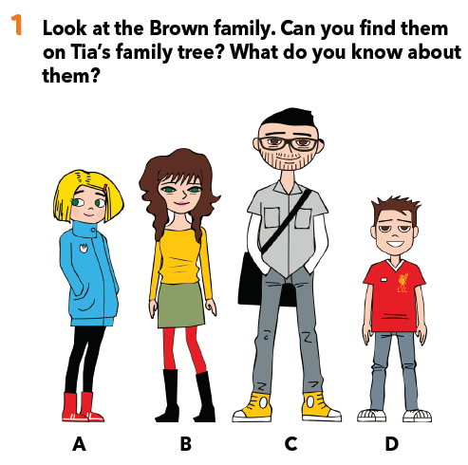
Look at the Brown family. What do you know about them. Describe the characters.
Can you find them on Tia’s family tree?

Slide 3
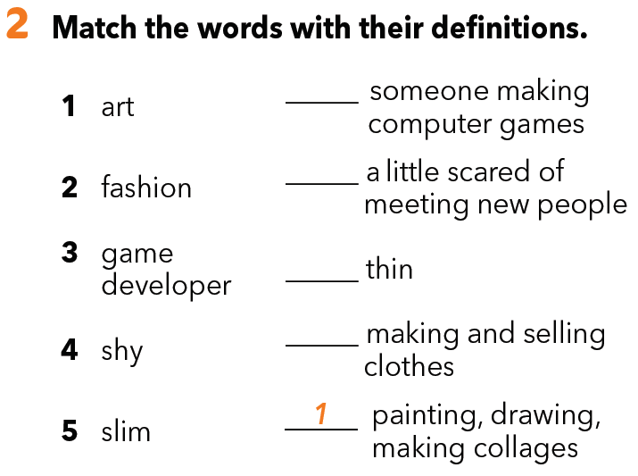
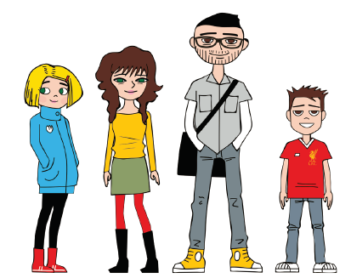
Match the words (1-5) with their definitions.
3
4
Write a few sentences on your own and use these words in the sentences.
5
2
Which of these words go with which character? Can you guess?
Who likes art?
Who likes fashion?
Who is a game developer?
Who is shy?
Who is slim?

Slide 4
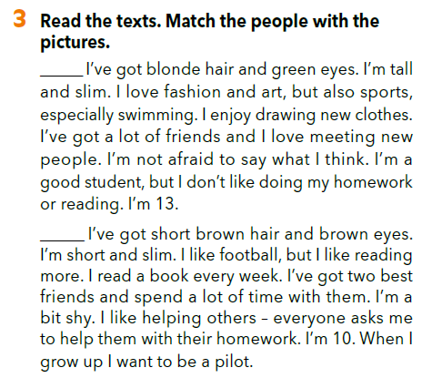
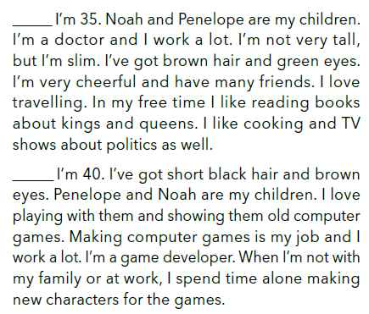
Skim the texts in your book.
Which texts are about Penelope and Noah and which ones are about Anne and Joseph?

Slide 5
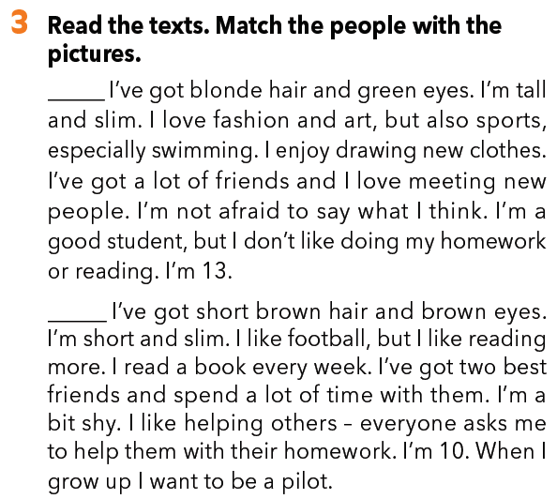
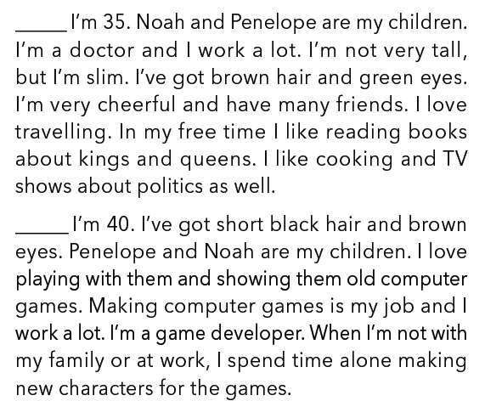
Match the texts with the pictures (A-D) from task 1. Check again.
A
https://www.bookwidgets.com/play/t:zVWiLtVJqCa+XE6YnInm2HsX3Qmfav/JZHT8UDFntCJURUpUS0o=
C
D
B
Which character is the text about?
e.g. The first text is about Penelope. …

Slide 6
A
Practise reading the texts aloud.
You can use different voices (e.g. computer voice, as if you were tired and/or sad).
D
C
B

Slide 7
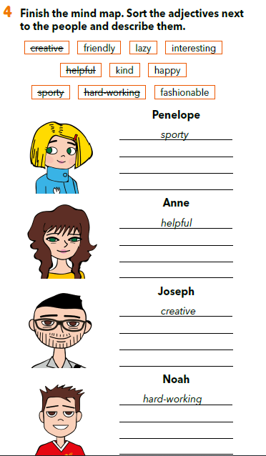
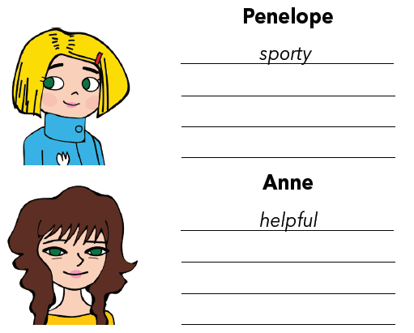
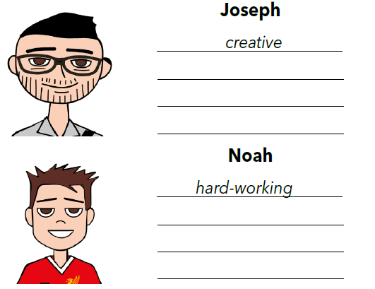
Sort the adjectives next to the people.
Describe them.
friendly
lazy
fashionable
happy
interesting
kind

Slide 8
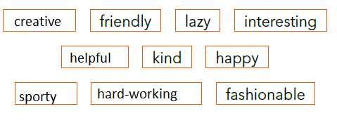
Use the adjectives from task 4 and say three sentences about one of your family members.

Slide 9
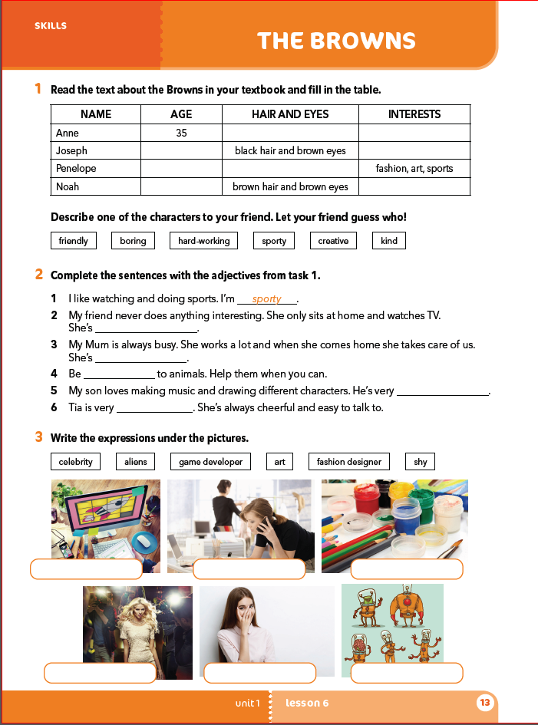
Workbook, page 13.

Slide 10
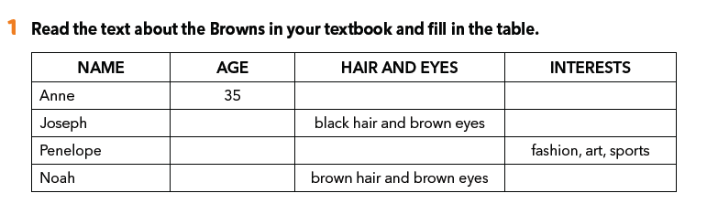
brown hair and green eyes
travelling, reading cooking, politics
40
old computer games, creating new characters
13
blond hair and green eyes
10
football, reading

Slide 11
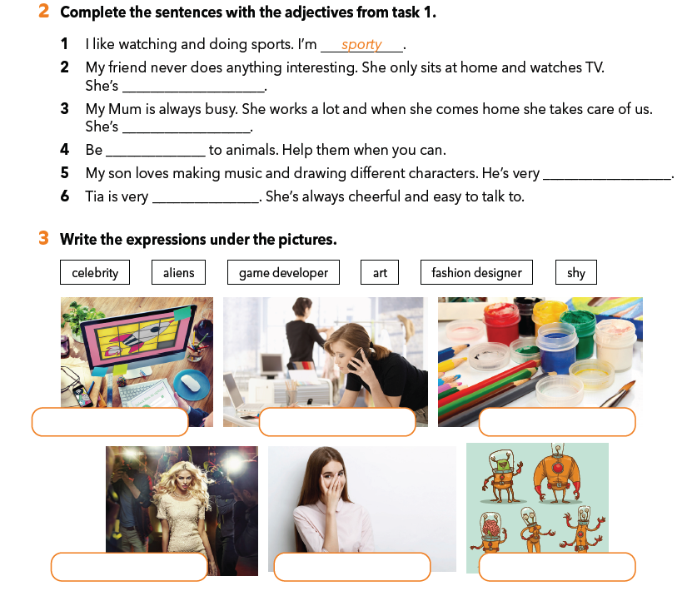
boring
hard-working
kind
creative
friendly
game developer
fashion designer
art
celebrity
shy
aliens

